Slide 1
How to resize components of VM

Slide 2
All configuration options and settings visible in this presentation can be different than yours. It depends on you privileges, settings and agreement.

Slide 3
Log in to VM Cloud Services

Slide 4
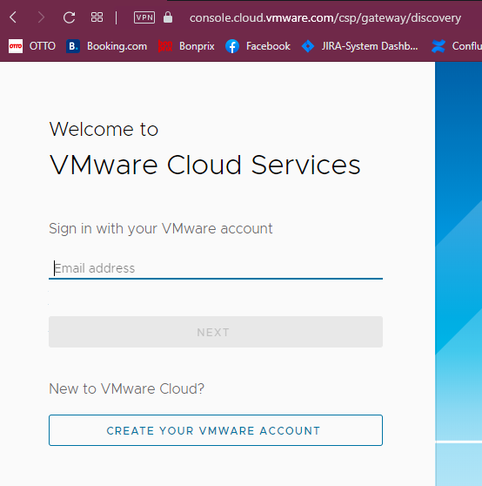
Enter the email address previously added to VMware Cloud Services

Slide 5
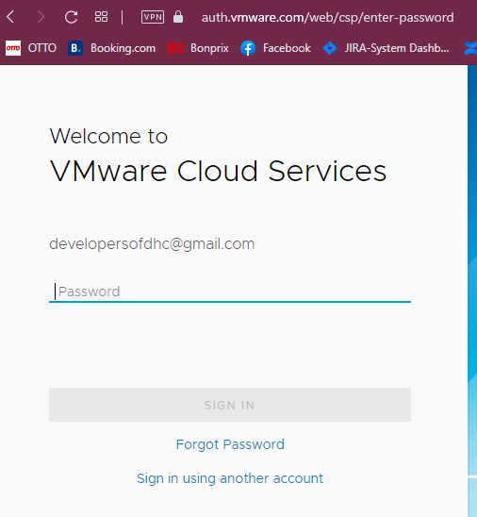
Enter the password for your account

Slide 6
Resize the VM compontents

Slide 7
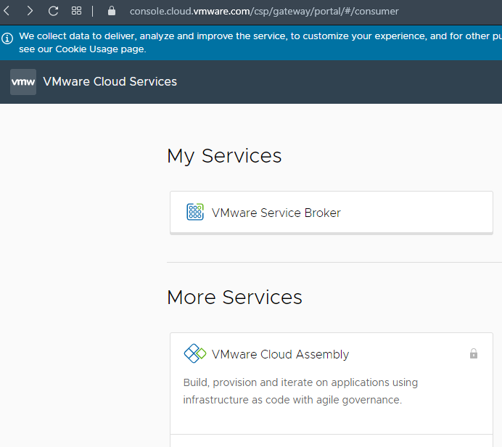
In Section “My Services” find a block with the title “Vmware Service Broker” – click on it.
Notice:
look of this page is up to your privileges and roles which are assigned to your account

Slide 8
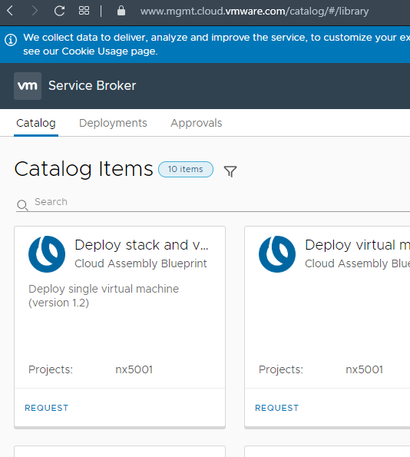
Please find the card “Deployments” on the top of a page. Click them.
Notice:
You have to have already deployed Virtual Machine. Without VM you cannot add a disk to them.

Slide 9
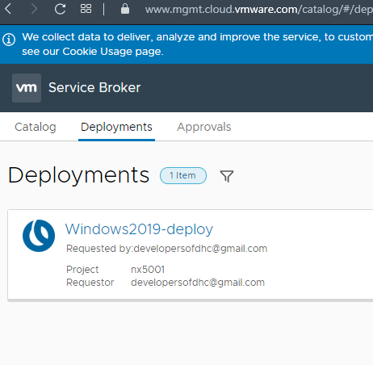
Find the machine you want to add the disk to. When you find an appropriate machine, click on the title of a finished process.
Notice:
On the page you can see many finished processes which deployed a single machine or series of machines. To identify the machine look on the title of a finished process.

Slide 10
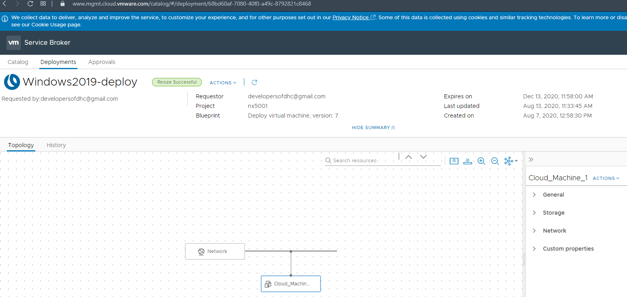
click “ACTIONS” in the menu on the right

Slide 11
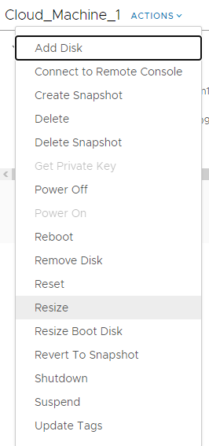
In the menu find the “Resize” and click on it. You will see new windows which allow you to resize the components like vCPU or memory of the VM.
Notice:
This option like others can be disabled. It depends on your privileges.

Slide 12
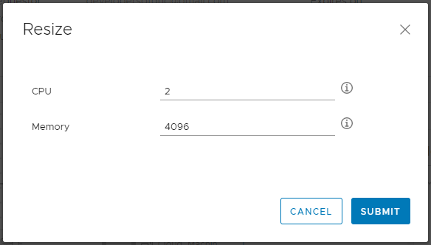
Count of vCPU and memory. You can define a new size of this parameters.
Notice:
Each flavor has different minimum and maximum limits. Be sure you create a VM with a proper flavor.
When you fill in this form click SUBMIT

Slide 13
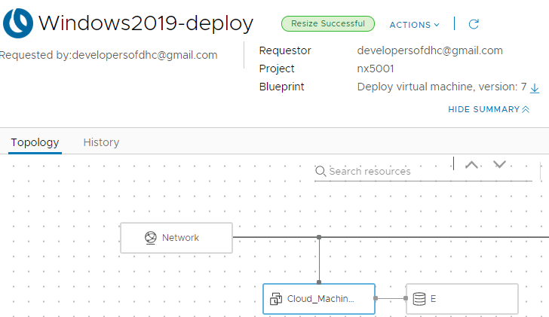
Status of a process
Notice:
When the process ends with an error, the label will be red with information about the error.

Slide 14
Thank you For more information please contact: T+ 33 1 98765432 M+ 33 6 44445678 firstname.lastname@atos.net

